Slide 1
Hands Up! This Is a ROPpery!
Introduction to Defeating DEP with ROP
Connor McGarr

Slide 2


root@bajablast:~$ whoami
Connor McGarr
Southeast Missouri State University
Class of 2019
Red Team Consultant @ CrowdStrike
Full time meme connoisseur
Offensive Security Certified Professional (OSCP)
Offensive Security Certified Expert (OSCE)
Blog
https://connormcgarr.github.io

Slide 3

Why Am I Giving This Talk?
Exploit mitigations (EMET, SMEP, DEP, etc) all have tedious bypasses
An attacker at the end of the day, with enough time, will be able to bypass these mitigations
Demonstrate how a protection can be bypassed and why application security/secure development should be taken more seriously
Implementing security earlier into the software development lifecycle = less of a dependence on things like EDR, exploit mitigations, etc

Slide 4
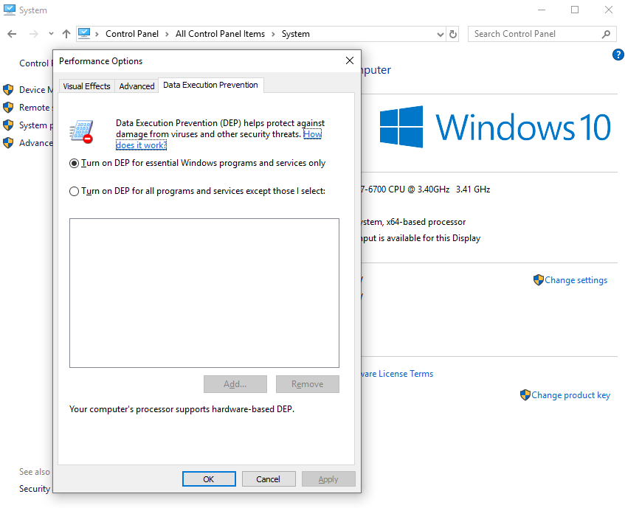
DEP = Data Execution Protection
Stack = Data structure, in memory, used by an OS/application to hold temporary data
Stack has either write or execute permissions- but not both

Slide 5
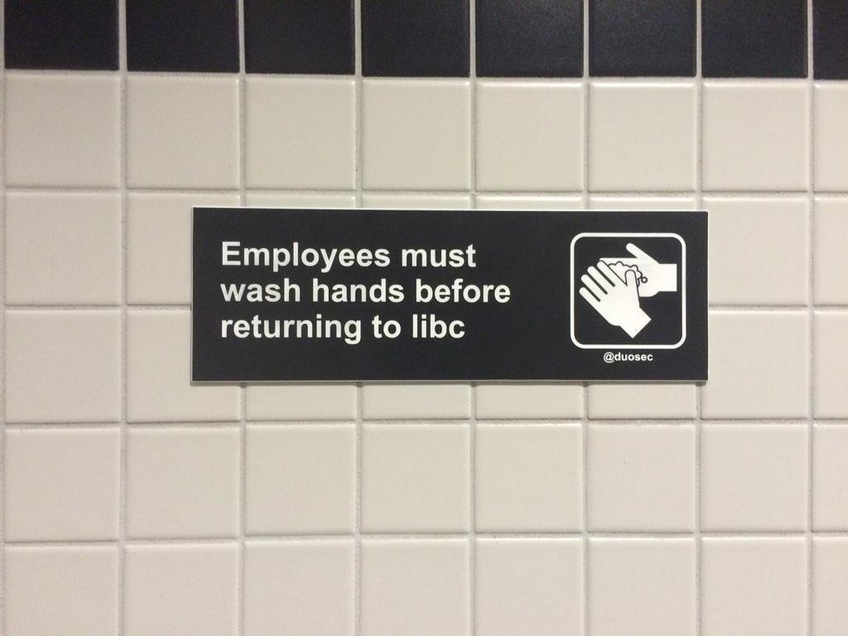
Let’s ROP ‘n Roll
ROP = Return Oriented Programming
High Level
Disassemble an application for existing assembly
instructions and the use stack to store these instructions
Gadget
An assembly instruction within the application that is followed by a “ret”, or return instruction
Chain
A series of ROP gadgets
We can execute existing assembly instructions within an application, but not foreign ones
Goal:
1. Write a malicious payload to the stack
2. Chain together ROP gadgets found within an application/OS to change the permissions of the portion of the stack containing said malicious payload to allow execution

Slide 6
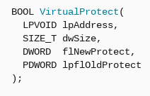
Windows API - VirtualProtect()
Applications in Windows utilize memory
Windows API functions allow us to interact with said memory
VirtualProtect() – used to change permission of memory
lpAddress
Pointer to address where permission change starts (malicious payload)
dwSize
Size of region being changed (size of the malicious payload)
flNewProtect
Level of permissions (Payload should be read, write, and execute)
lpflOldProtect
Pointer to any writeable address that will inherit old permissions
Only needed to execute the function. Not important.
Microsoft MDSN

Slide 7
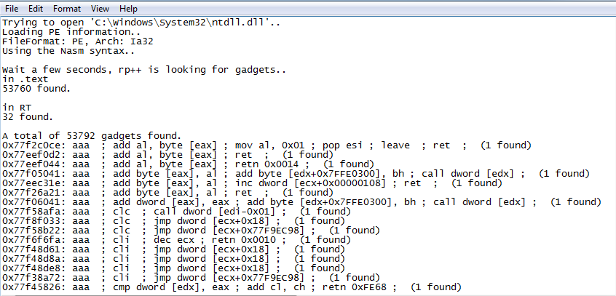
Generating ROP Gadgets with rp++
https://github.com/0vercl0k/rp
Can specify file and length of ROP gadgets

Slide 8
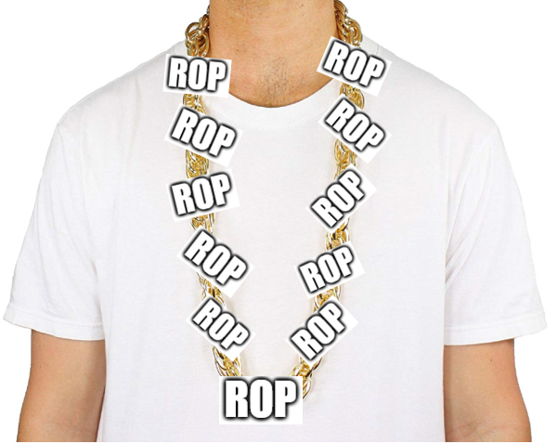
Exploit Development- High Level Overview
1. Return back to the stack (stack pivot)
2. Setup VirtualProtect() function call with junk placeholders
Write malicious payload to the stack
Jump over the VirtualProtect() function call into ROP chain
ROP chain changes junk placeholders to actual function parameters
VirtualProtect() changes permissions of malicious payload on the stack to allow execution. Then, the exploit will jump to the malicious payload
The malicious payload executes, allowing unauthenticated remote access to victim
← A 1337 ROP chain

Slide 9
1st Stage (Stack Pivot, Junk Parameters, and Jumping to Shellcode)

Slide 10
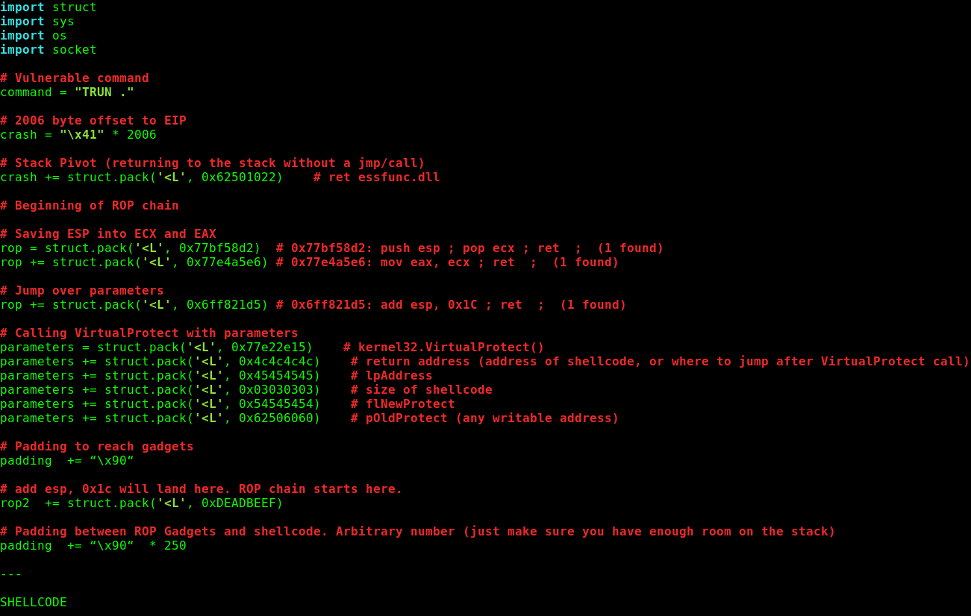
Vulnerable application : vulnserver.exe (https://github.com/stephenbradshaw/vulnserver)
Skeleton exploit written in PYTHON
Return to stack, with no “jmp esp”
Beginning of ROP chain (explained in next 2-3 slides)
VirtualProtect() junk parameter placeholders
NOP padding
Malicious payload that will eventually be executed

Slide 11
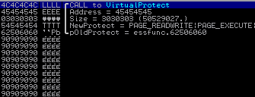
Debugger View
Return to shellcode (needed for return to shellcode after VirtualProtect() call)
lpAddress placeholder
dwSize placeholder
flNewProtect placeholder
lpflOldProtect

Slide 12
Debugger View
Return to shellcode (needed for return to shellcode after VirtualProtect() call)
lpAddress placeholder
dwSize placeholder
flNewProtect placeholder
lpflOldProtect

Slide 13
Debugger View
Return to shellcode (needed for return to shellcode after VirtualProtect() call)
lpAddress placeholder
dwSize placeholder
flNewProtect placeholder
lpflOldProtect

Slide 14
Debugger View
Return to shellcode (needed for return to shellcode after VirtualProtect() call)
lpAddress placeholder
dwSize placeholder
flNewProtect placeholder
lpflOldProtect

Slide 15
Debugger View
Return to shellcode (needed for return to shellcode after VirtualProtect() call)
lpAddress placeholder
dwSize placeholder
flNewProtect placeholder
lpflOldProtect

Slide 16
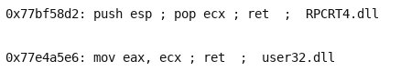
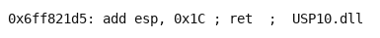
Saving the Stack Pointer & Jump Into ROP Chain
CPU registers = used for storing information such as memory addresses, etc
ESP = pointer to the stack (in an x86 architecture)
ROP gadgets to save current stack pointer into EAX/ECX:
ROP gadget to jump over VirtualProtect() placeholders and into ROP chain:
At this point….
EAX = old ESP value
ECX = old ESP value

Slide 17
2nd Stage (return and lpAddress parameters)

Slide 18
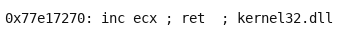
ROP - Return and lpAddress
Currently: ECX = ESP
Location of return placeholder = 12 bytes greater than memory addresses stored in ECX
We want to store the return placeholder location in a CPU register
Increase ECX 12 bytes
ECX now holds the address of the return placeholder
ROP gadget to do this (Repeat 12 times):
Return placeholder
At this point….
EAX = old ESP value
ECX = return placeholder memory address

Slide 19
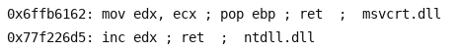
ROP - Return and lpAddress
lpAddress parameter placeholder location = 1 memory location after return placeholder (return address is stored in ECX). 1 memory location = 4 bytes in x86
Move ECX into EDX. Then, increase EDX 4 bytes (EDX now contains address of lpAddress placeholder location)
ROP gadgets to accomplish this:
lpAddress placeholder
At this point….
EAX = old ESP value
ECX = return placeholder memory address
EDX = lpAddress placeholder memory address

Slide 20
ROP - Return and lpAddress
EAX still contains old ESP value.
Shellcode is about 250 bytes down the stack
Return/lpAddress needs to equal shellcode location
Just need to land in NOPs (which do nothing)
The NOPs will just “slide” into our malicious payload
ROP gadget to increase EAX 200 bytes (Repeat 2 times):
VirtualProtect()
placeholder
ROP chain
250-byte padding of NOPS
Malicious payload
At this point….
EAX = location of shellcode (NOPs)
ECX = return placeholder memory address
EDX = lpAddress placeholder memory address
NOP sled

Slide 21
ROP - Return and lpAddress
Goal now is to make placeholders for return & lpAddress point to actual parameters
Return & lpAddress need to equal malicious payload location
EAX contains the location of the malicious payload
ROP gadget to create pointer from placeholders to ACTUAL values:
At this point….
EAX = location of shellcode (NOPs)
ECX = return placeholder memory address
EDX = lpAddress placeholder memory address

Slide 22
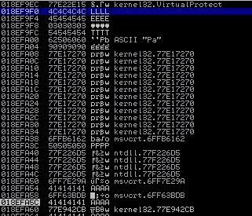
Debugger view
Before pointer is created:
Return
lpAddress

Slide 23
Debugger view
Before pointer is created:
Return
lpAddress

Slide 24
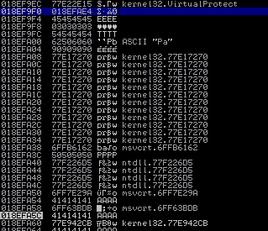
Debugger view
After pointer is created:
Return (location of shellcode)
lpAddress

Slide 25
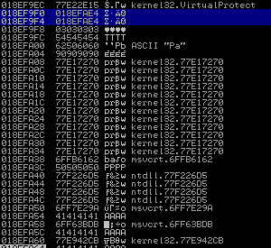
Debugger view
After pointer is created:
Return
lpAddress (location of shellcode)

Slide 26
3rd Stage (dwSize & flNewProtect parameters)

Slide 27
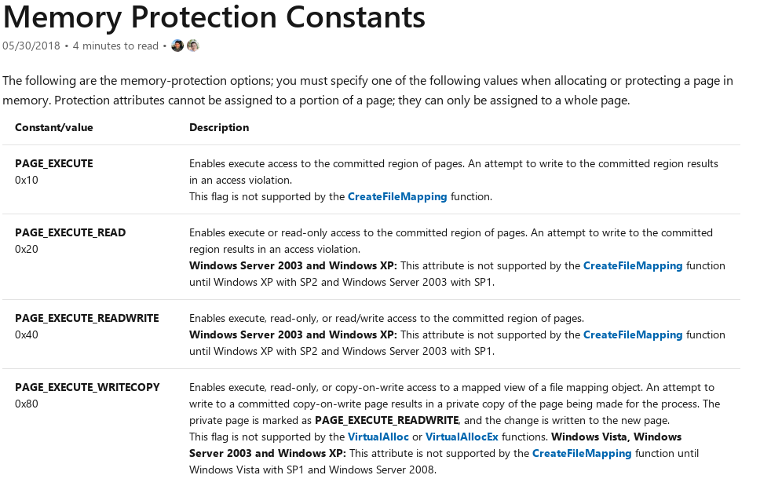
ROP - dwSize & flNewProtect
dwSize should be 0x300 hex (678 decimal. More than enough for a shell payload)
flNewProtect should be 0x40 - which represents RWX permissions:
Microsoft MSDN

Slide 28
ROP - dwSize & flNewProtect (cont’d)
ROP gadgets for dwSize (zero out EAX for calculations):
EAX now equals 0- we can add 300 straight to it
Repeat three times (to equal 0x300):
At this point….
EAX = dwSize value
ECX = return placeholder memory address
EDX = lpAddress placeholder memory address

Slide 29
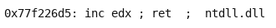
ROP - dwSize & flNewProtect (cont’d)
Currently, EDX = lpAddress placeholder address. We want EDX to contain the address of the dwSize placeholder instead (we eventually want to create a pointer):
ROP gadget to increase EDX four bytes (repeat four times) to accomplish this:
- lpAddress (current EDX value)
dwSize (what we want EDX to contain)
At this point….
EAX = dwSize value
ECX = return placeholder memory address
EDX = dwSize placeholder memory address

Slide 30
ROP - dwSize & flNewProtect (cont’d)
Currently, EDX = lpAddress placeholder address. We want EDX to contain the address of the dwSize placeholder instead (we eventually want to create a pointer):
ROP gadget to increase EDX four bytes (repeat four times):
- lpAddress (current EDX value)
- dwSize (what we want EDX to contain)
At this point….
EAX = dwSize value
ECX = return placeholder memory address
EDX = dwSize placeholder memory address

Slide 31
ROP - dwSize & flNewProtect (cont’d)
Just as with return and lpAddress- create a pointer from the dwSize parameter placeholder address (stored in EDX), to the intended dwSize value (stored in EAX):
At this point….
EAX = dwSize value
ECX = return placeholder memory address
EDX = dwSize placeholder memory address

Slide 32
ROP - dwSize & flNewProtect (cont’d)
Repeat the same process with flNewProtect:
No useful gadgets for directly adding 0x40. Keep repeating until 0x40 is reached:
At this point….
EAX = flNewProtect value
ECX = return placeholder memory address
EDX = dwSize placeholder memory address

Slide 33
ROP - dwSize & flNewProtect (cont’d)
EDX = dwSize placeholder. We want EDX to contain the address of the flNewProtect junk parameter placeholder (so we can make a pointer to legit parameter):
- ROP gadgets to increase EDX four bytes (repeat four times) and create a pointer :
- dwSize (current EDX value)
- flNewProtect (what we want EDX to contain)
At this point….
EAX = flNewProtect value
ECX = return placeholder memory address
EDX = flNewProtect placeholder memory address

Slide 34
ROP - dwSize & flNewProtect (cont’d)
EDX = dwSize placeholder. We want EDX to contain the address of the flNewProtect junk parameter placeholder (so we can make a pointer to legit parameter):
- ROP gadgets to increase EDX four bytes (repeat four times) and create a pointer :
- dwSize (current EDX value)
- flNewProtect (what we want EDX to contain)
At this point….
EAX = flNewProtect value
ECX = return placeholder memory address
EDX = flNewProtect placeholder memory address

Slide 35
Last Stage (Jumping back to VirtualProtect())

Slide 36
ROP - Jumping back to VirtualProtect
Currently, ECX still contains the return parameter memory address, as shown below:
At this point….
EAX = flNewProtect value
ECX = return placeholder memory address
EDX = flNewProtect placeholder memory address

Slide 37
ROP - Jumping back to VirtualProtect
Now shown, is where the call to VirtualProtect() happens
The goal now is to use ROP to get this address into ESP and kick the function call off
As you can see, the return parameter is 1 address space ahead of the call to VirtualProtect()
At this point….
EAX = flNewProtect value
ECX = return placeholder memory address
EDX = flNewProtect placeholder memory address

Slide 38
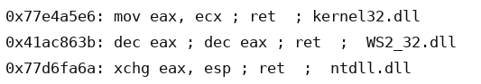
ROP - Jumping back to VirtualProtect
Decrementing ECX 4 bytes will make ECX = VirtualProtect()
No useful gadgets for decrementing ECX directly.
Instead, move ECX into EAX. Now EAX = ECX.
Then, exchange EAX with the ESP register- and kick off the function call with a return:
At this point….
EAX = old ESP (from exchange EAX, ESP instruction)
ECX = VirtualProtect() memory address
EDX = flNewProtect placeholder memory address
ESP = VirtualProtect() memory address

Slide 39
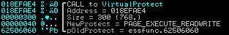
Debugger View – Final Function Call
- Return to shellcode
lpAddress
dwSize
flNewProtect
lpflOldProtect

Slide 40
Debugger View – Final Function Call
Return to shellcode
- lpAddress
dwSize
flNewProtect
lpflOldProtect

Slide 41
Debugger View – Final Function Call
Return to shellcode
lpAddress
- dwSize
flNewProtect
lpflOldProtect

Slide 42
Debugger View – Final Function Call
Return to shellcode
lpAddress
dwSize
- flNewProtect
lpflOldProtect

Slide 43
Debugger View – Final Function Call
Return to shellcode
lpAddress
dwSize
flNewProtect
- lpflOldProtect

Slide 44
Demo :-)

Slide 45
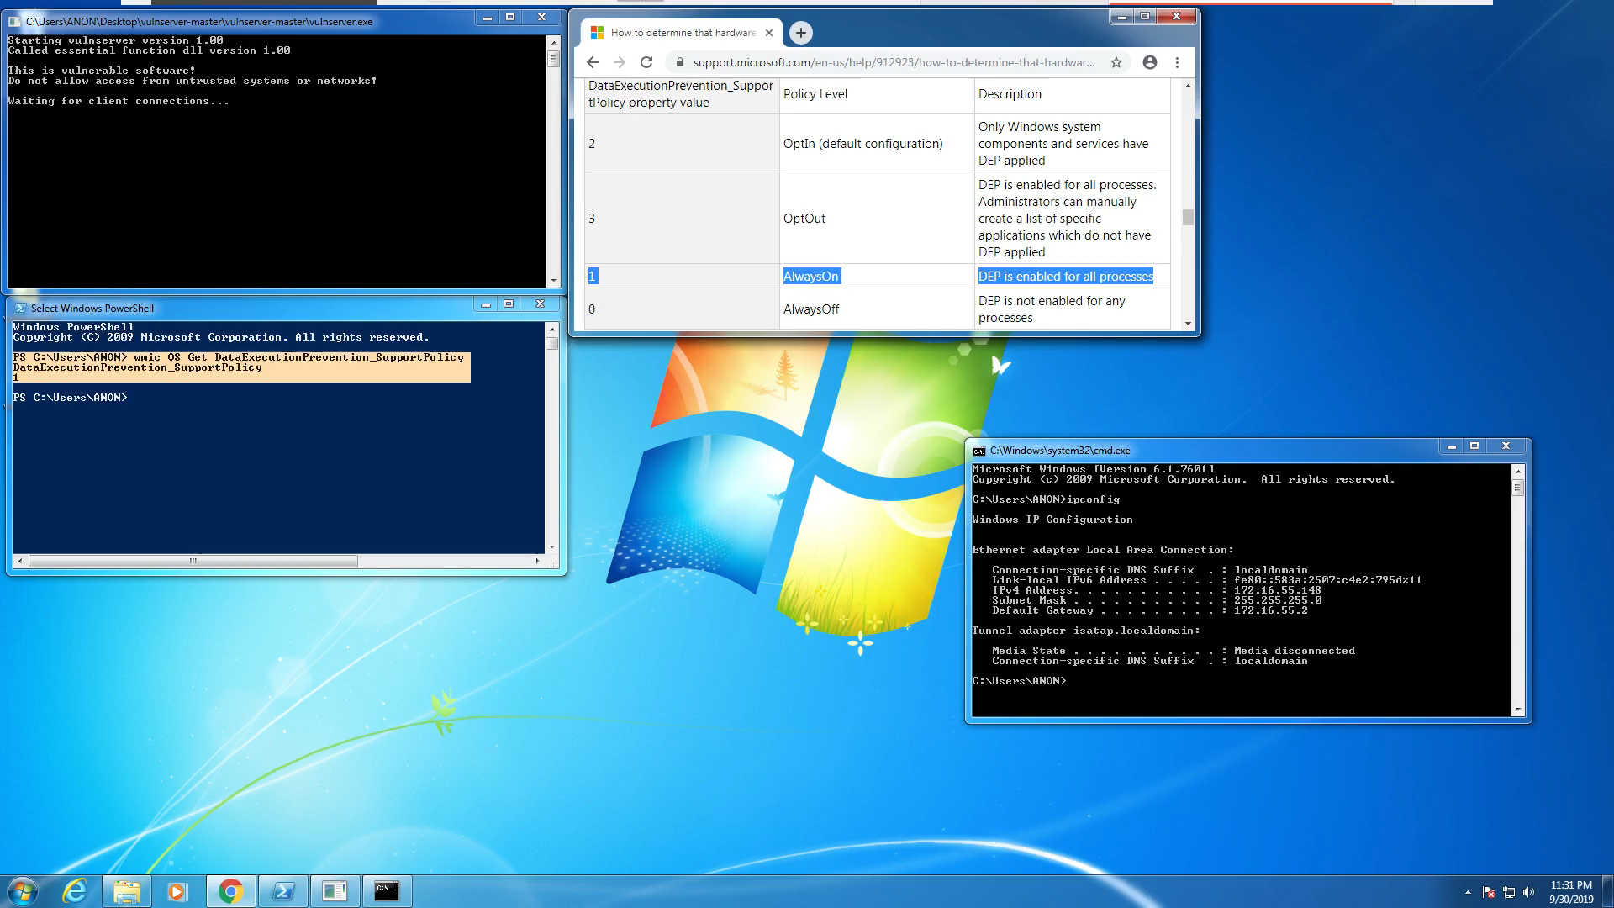

Slide 46
Resources
Corelan Exploit Development
Microsoft Docs (MSDN)
rp++ tool written by 0vercl0k
Vulnserver written by Steven Bradshaw

Slide 47

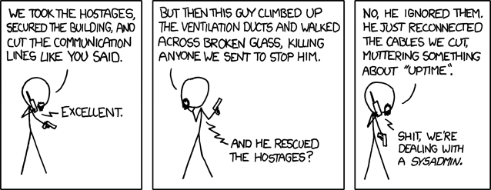
Thank you! w00tw00t!

